Slide 1
European Livestock and Meat Trades Union – UECBV
Presentation:

Slide 2
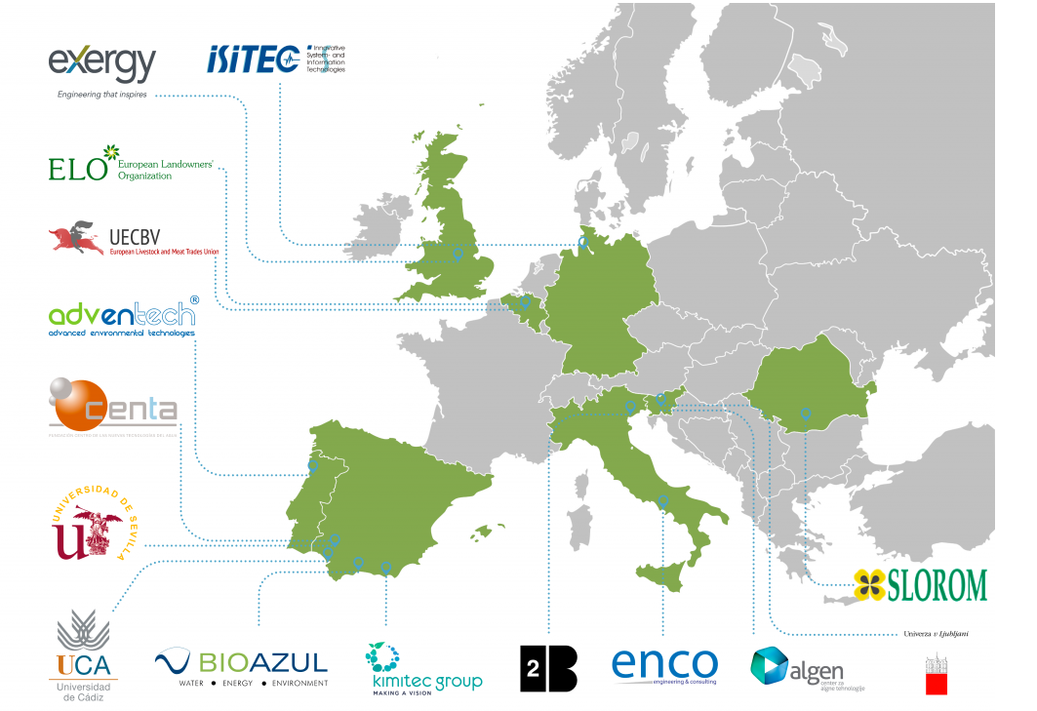
European Livestock and Meat Trades Union – UECBV
Water2REturn is an Innovation Action co-funded by the European Commission under its Horizon 2020 program.
It brings together 15 multidisciplinary actors from 8 different European countries – 9 SMEs, 2 European associations, 1 research center and 3 universities – to implement an integrated solution for slaughterhouse wastewater treatment, as well as for the recovery of nutrients with high market value in the agricultural sector.
It was submitted under the call “Industry 2020 in the Circular Economy” (call identifier H2020-IND- CE-2016- 17), topic “Water in the context of the circular economy” (topic identifier CIRC-02- 2016-2017).

Slide 3
European Livestock and Meat Trades Union – UECBV
Members of the project

Slide 4
Objectives
Development of a demonstrative application for slaughterhouse wastewater treatment and large-scale nutrient recovery.
Manufacturing of organic-source fertilizers and biostimulants in production lines built up within Water2REturn project timeframe.
Nutrients recovery rates of 90-95 % (N and P) and reduction of wastewater discharged to the environment by 90%.
Reduction of waste diverted to landfills by 80%.
Biogas upgrading and valorization allowing achievement of self-sufficiency rates and savings of up to 25% in the slaughterhouse.
Creation of new business opportunities and green jobs around nutrient recovery and recycling technologies, especially for SMEs in EU.
A reduction of costs and emissions.
A more efficient use of energy and resources.
A cascade use of materials.

Slide 5
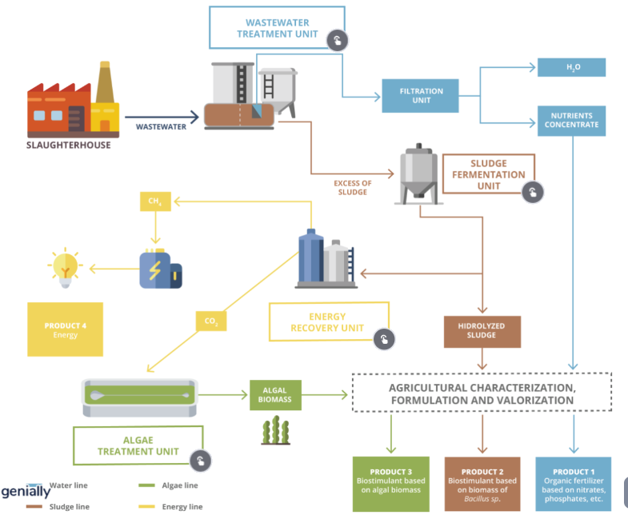
Commercial Outcomes Scheme

Slide 6
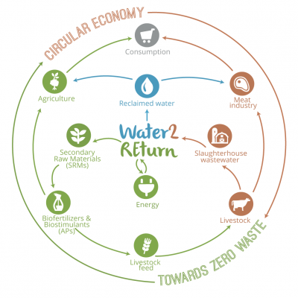

Slide 7
www.uecbv.eu
Thank you very much for your attention!

